Slide 1
Turbulence Effects on Species Exchange in Dynamic Chambers Between Porous Soil and Entrainment Air
By Ahmed Al Makky
Notes:
Thanks for coming. I will Introduce you to my research project through a brief history. The thesis topic was proposed by Professor Robert Kerr after meeting Dr Kelly Redeker a researcher at the University of York. What contributed to the adoption of the project idea was that the University of York biology group already has experimental data available to which we can validate our Numerical simulations results against.
The title of my project is Turbulence Effects on Species Exchange between Soil and Ambient Air. As a title it looks complex. It can be described as the production of controllable and reproducible turbulent diffusion through the use of blowing fans in a confined control volume. In other words: The generation of pressure and velocity gradients simultaneously to achieve species diffusion for the best spices exchange between the soil air interface.

Slide 2
Notes:
Climate change is one of the main challenges facing humanity in the 21 century. Therefore the quantification of soil respiration is no longer just a complicated academic issue. It has become relevant to the new generation of farmers, foresters, and government officials. Carbon dioxide released by soil respiration is a greenhouse gas that will continue to trap energy and increase the global mean temperature if concentrations continue to rise. As global temperature rises, so will the rate of soil respiration across the globe thereby leading to a higher concentration of carbon dioxide in the atmosphere, again leading to higher global temperatures. A small rise of temperature on this planet occurs on a yearly basis. It is predicted that a rise in temperature by 2 degrees Celsius will lead to an additional release of 10 Pg (Peta grams) carbon per year to the atmosphere from soil respiration. This is a larger amount than current carbon emissions produced by human kind activity. There also exists a possibility that this increase in temperature will release carbon stored in permanently frozen soils in the north and south pole, where the ice caps are now melting. Researchers using climate models have suggested that this positive feedback between soil respiration and temperature will lead to a decrease in soil stored carbon by the middle of this century. In conclusion to predict changes in the carbon cycle in response to global change, soil respiration has to be carefully studied by scientists.

Slide 3
Notes:
The earliest studies on soil respiration date back to the 1830s, they were conducted by incubating soil samples in the laboratory and measuring their metabolism. At the end of the 19th century, chemical fertilizers were invented to enhance agricultural productivity. Soil respiration was used as an index of soil fertility. During the same period of time scientists started seeing a relationship between soil water content and microbial activity.
More than 80 years ago the Swedish scientist Hendik Lundegardh constructed a chamber that he called 'respiration bell' in order to measure soil respiration. Hendik Lundegardh argued that diffusion was a chief process controlling efflux of carbon dioxide. Based on his design scientists have adopted the concept but with the addition of newly developed sensors and with the use of lighter material. These developments in turn have made the chambers easier to deploy on site and the used sensors have become highly sensitive to capture minute changes in species concentration (example e.g. IRGA sensors) which requires little training than the traditional alkali or soda-lime absorption methods.
Soil respiration plays a critical role in the regulation of carbon cycling on regional and global scales.
Measuring gas emissions from soil and water surfaces to the atmosphere is done through the use of the Enclosure-based methods, which have either static or dynamic flux chambers. The main objective of this experimental set up is to replicate the environmental interaction between soil and air. The experimental apparatus follows the closed dynamic chamber method. That is conducted through placing a cylindrical shaped chamber without a bottom cover over soil surface. Currently, the closed dynamic chamber mode of operation is the most common method researchers use to measure soil respiration. All trace gas flux measurements were performed using a novel toroidal static flux chamber TSFC equipped with internal fans placed within a larger straight-line wind tunnel. This combination allowed control over wind speeds both internal and external to the TSFC.

Slide 4
Notes:
Numerical flow simulations where run. This is a perspective view of the chamber, using the stream line tool, we can follow the particles path from the specified origin which is the fan surface. The blowing jets shape is visible and how they interact with the outer shell of the cylinder. This interaction is made through the jet being reflected in the direction of the flow just like the case of a flow in a pipe elbow fitting. When following these structures through using stream line representations along the cylinder walls a clear rotational flow is observed, referring to a periodic condition. Another visible aspect is the connecting rod connections near the soil where some particles jump over the connecting rods while the others slip through the gaps

Slide 5
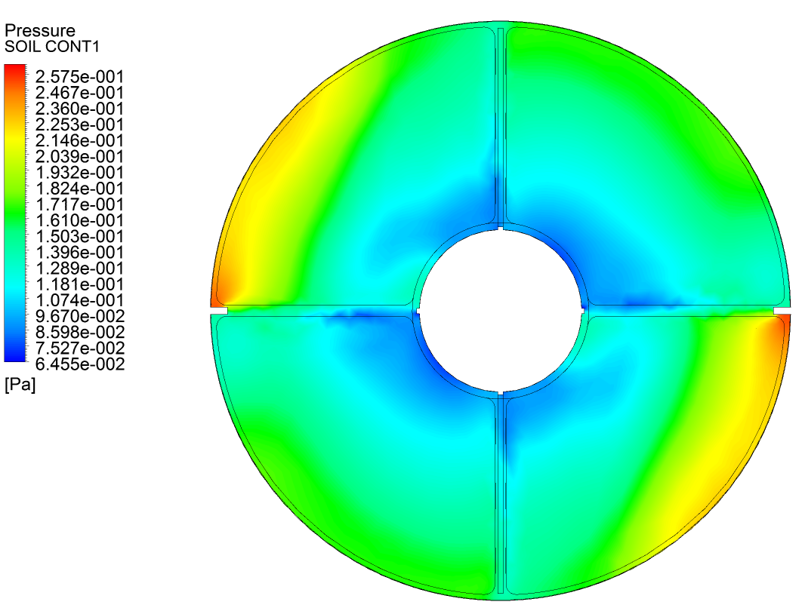
Notes:
This is a top view of the chamber, showing pressure distribution regions on the soil surface. The red regions are the high pressure regions resulting from the conversion of kinetic energy of the blown flow to static energy after hitting the outer shell wall into stagnation pressure, it can be seen that this high pressure region is trapped by the connecting rod containing the red region in one quarter of the chamber, the mentioned region doesn't play a positive role in the species extraction from the soil. This proves that masses of circulating air accumulates around the outer shell. Meaning air in this case would leak out in small quantities if the pressure inside the chamber is higher than the outside pressure.

Slide 6
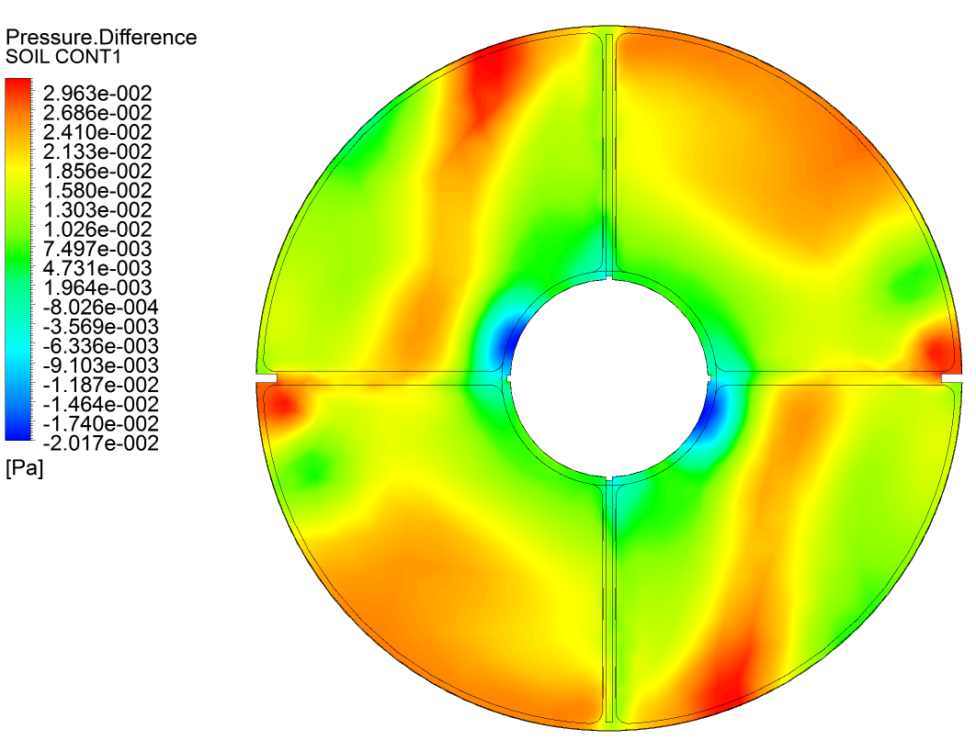
Notes:
This is a top view of the chamber, represents the difference frame for a period of time equivalent to 10 seconds. Looking at the figure key indicates that the red colour represents regions of high pressure build up. We must draw the attention that the pressure differences in question are very small. Meaning if we add any of these differential values to the pressure in the chamber, it will not change that pressure beyond the value of 1 atmosphere in a sensible way. The regions of pressure build up are a result of the blown jet flux at the outer chamber walls getting reflected back from the soil surface.

Slide 7
Notes:
The top view of the Quonset greenhouse, shows the suction effects near the cylindrical chamber inside the Quonset greenhouse, which resulted from the three blowing fans. The blowing velocities chosen by the University of York research group were ranging from 2.6 to 3.2m/s. By merging the pressure contour plots inside and outside the chamber we can run flow simulations inside the soil domain.

Slide 8
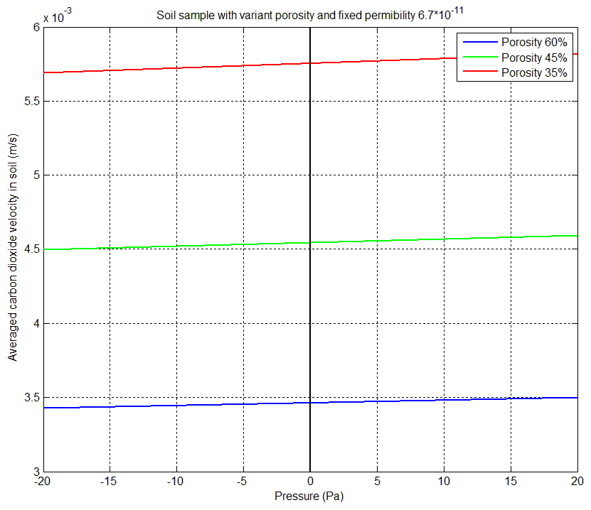
Leakage Flux into Chamber
Notes:
Extracted results showing the relationship between pressure and carbon dioxide velocity in soil, for a fixed inside chamber pressure and an outer variable pressure. Therefore by knowing the pressure difference between inside and outside the chamber we can approximate the average carbon dioxide velocity inside the soil domain. In conclusion by using derived formulas we can approximate the leakage flux. Th is amply was studied with variable porosity and constant permeability.

Slide 9
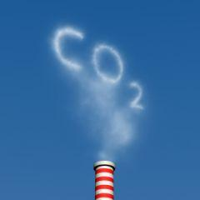
Thank you
Any Questions?

